Slide 1



Slide 2



 | Slope Bins 4 | Smear Count 25
Block number | Alpha w/ Henderson Hasselbalch | Chi Chi_max = 2.2
[0 50] | 0.040012 | 1.160000
[50 75] | -0.278451 | 0.720000
[75 125] | -0.519707 | 0.608000
[125 156] | -0.154453 | 0.529032

Slide 3


 | Slope Bins 4 | Smear Count 31
Block number | Alpha w/ Henderson Hasselbalch | Chi Chi_max = 2.2
[0 31] | 0.001103 | 0.922581
[31 62] | -0.386873 | 0.703226
[62 93] | -0.290146 | 0.967742
[93 496] | 0.037164 | 1.098759
[496 527] | -0.064533 | 0.819355
[527 620] | 0.010682 | 0.756989
[620 647] | -0.103326 | 0.696296

Slide 4
Binary results

Slide 5



Matrix Approach
Updated 04/04/2023

Slide 6














H Vol decrease (by v)
H Vol decrease (by b)
Desired “linearity” by tuning /thresh/ based on polymer density of expelled NFL
L Vol decrease (by b)
Comes at severe cost of overall height. Have to minimize outer concentration to approach pure thresh of 1e-06

Slide 7














H Vol decrease (by v)
H Vol decrease (by b)
Chimax 3.5
Desired “linearity” by tuning /thresh/ based on polymer density of expelled NFL
L Vol decrease (by b)
Comes at severe cost of overall height. Have to minimize outer concentration to approach pure thresh of 1e-06

Slide 8








F (3.5)
Chimax 3.5
Chimax 3.0
Scaled by 1.5
Scaled by 1.6
Scaled by 1.6
Scaled by 1.5
Scaled by 1.5
Scaled by 1.5
Scaled by 1.8
Scaled by 1.8

Slide 9
















Last test: same stiffness factor (b^3/v0) but with varying total volume

Slide 10












H Vol decrease (by v)
H Vol decrease (by b)
a2C_30
a2D_30
a2E_30
Rerun for Cs
b1C_30
b1D_30
b1E_30
L Vol decrease (by b)
a1C_30
a1D_30
a1E_30
g1C_30
g1D_30
g1E_30
Rerun for Cs

Slide 11












H Vol decrease (by v)
H Vol decrease (by b)
a2C
a2D
a2E
b1C
b1D
b1E
Block 4 (NFL end)
L Vol decrease (by b)
a1C
a1D
a1E
g1C
g1D
g1E

Slide 12









H Vol decrease (by v)
Chimax 3.5
H Vol decrease (by b)
a2C_30
a2D_30
a2E_30
b1C_30
b1D_30
b1E_30
L Vol decrease (by b)
a1C_30
a1D_30
a1E_30
g1C_30
g1D_30
g1E_30

Slide 13







For i as L and H:
Pure height profiles
Mixed height profiles
Current L library
Current H library
Skip; marginal increase in vol prob not enough
Move onto chi3.0; larger NFL vol library

Slide 14





NFL
All plotting wrong L pure; look only at purp
NFH
H volume too low to neutralize L (v = 31 nm3/c)

Slide 15







H volume v = 60 nm3/c

Slide 16







H volume too low to neutralize L

Slide 17










NFH, V = 70
L30

Slide 18





NFH & NFL v = 0.15
a2D
b1D
g1D

Slide 19





Based on NFH b5v15c3, apply VL = VH
NFL and NFH are from same amino acids but diff chain lengths. Should VL = VH?
L30 / H70
L80 / H20
L30 / H70
L80 / H20

Slide 20






L30 / H70
L80 / H20
L30 / H70
L80 / H20

Slide 21
L Fitting

Slide 22


VL = VH

Slide 23







Try b change, v same as H (0.15)
Phi unrealistic (?)
Phi unrealistic
Phi very unrealistic
Phi very unrealistic

Slide 24






Try similar params to H
5.6
11.2
16.8
28
56
7.5
11.25
18.75

Slide 25







Try similar params to H, b0.36
7.8
15.6
23.4
31.2
Unrealistic vol
Not very sensitive to v; not high enough to intersect neighboring chains (function of b and sigma)

Slide 26


Continuation from prev params

Slide 27







v2.7 and some fine
b1.50 v2.7 c3.2
b1.75 v2.7 c3.2
b1.75 v2.5 c3.2
b1.75 v2.5 c3.0
b2.0 v2.7 c3.2
b2.25 v2.7 c3.2
b2.50 v2.7 c3.2
Phi too small to decrease v0

Slide 28










b2.0 v10.0 c3.0
b2.0 v8.0 c3.0
b2.0 v6.0 c3.0
b2.0 v4.0 c3.0
b2.0 v2.0 c3.0
Phi limit
b1.8 v10.0 c3.0
b1.8 v8.0 c3.0
b1.8 v6.0 c3.0
b1.8 v3.0 c3.0
b1.8 v2.0 c3.0
Phi limit

Slide 29





b1.6 v10.0 c3.0
b1.6 v8.0 c3.0
b1.6 v6.0 c3.0
b1.6 v2.0 c3.0
b1.6 v1.5 c3.0
Phi limit

Slide 30


Response to stimuli given composition
Same data
Effect of composition given environment

Slide 31


NFL, pH 7.44, phos 1.5e (locs from LCMS)
Non-phos NFL
Block number | Alpha w/ Henderson Hasselbalch | Chi Chi_max = 3.2
[0 50] | 0.040012 | 1.540000
[50 75] | -0.278451 | 0.960000
[75 125] | -0.519707 | 0.868000
[125 156] | -0.154453 | 0.690323
 | Slope Bins 4 | Smear Count 25
Block number | Alpha w/ Henderson Hasselbalch | Chi Chi_max = 3.2
[0 50] | -0.019988 | 1.540000
[50 75] | -0.278451 | 0.960000
[75 125] | -0.519707 | 0.868000
[125 156] | -0.154453 | 0.690323

Slide 32


NFH, pH 7.44, phos 1.5e (locs from LCMS)
 | Slope Bins 4 | Smear Count 36
Block number | Alpha w/ Henderson Hasselbalch | Chi Chi_max = 3.2 | Chi Chi_max = 3.0
[0 36] | 0.000945 | 1.266667 | 1.20000
[36 72] | -0.527455 | 0.900000 | 0.85000
[72 324] | -0.208376 | 1.729365 | 1.628571
[324 396] | -0.111195 | 1.416667 | 1.333333
[396 432] | -0.152824 | 1.344444 | 1.266667
[432 647] | -0.033955 | 1.077209 | 1.015814

Slide 33

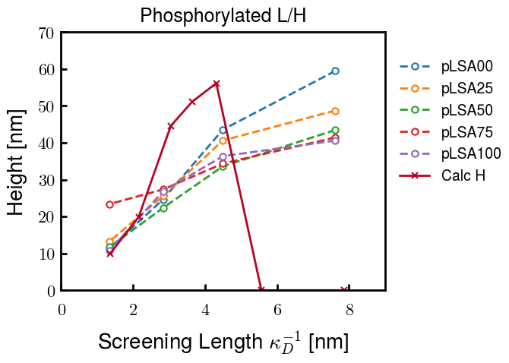
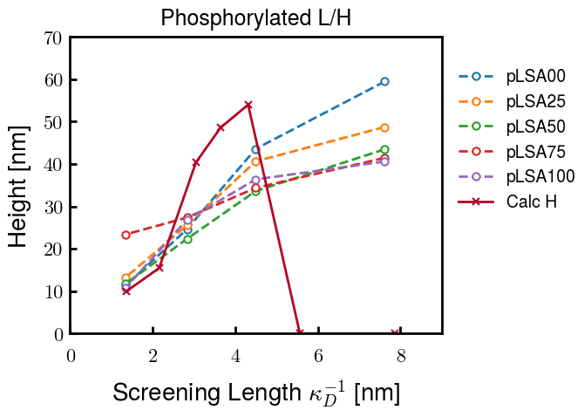
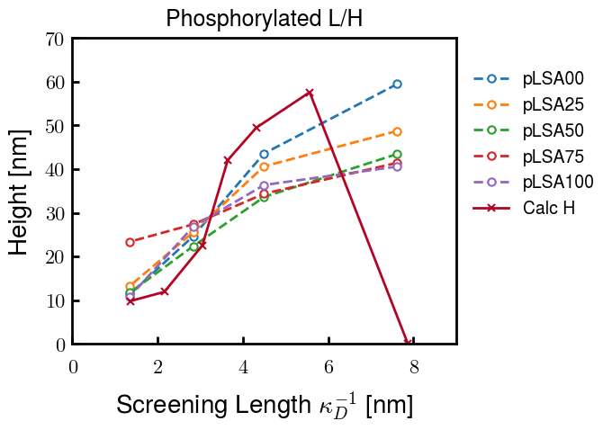
Instead of fitting b/v, could just change value of charge on phos. Try both and see if makes difference for mixture

Slide 34









b2.0 v2.7 c3.2
b3.0 v3.5 c3.5
b3.0 v7.0 c3.5
b3.0 v7.0 c3.0
Phi too small
Phi too small to decrease v0
b4.0 v12.0 c3.0
b5.0 v20.0 c3.0
b5.0 v20.0 c4.0
b5.0 v5.0 c3.0
b5.0 v10.0 c3.0
Phi too small to decrease v0

Slide 35





v20
b5.0 v20.0 c3.0
b4.5 v20.0 c3.0
b4.0 v20.0 c3.0
b3.5 v20.0 c3.0
v10
b5.0 v10.0 c3.0
b4.0 v10.0 c3.0
b3.0 v10.0 c3.0
b2.0 v10.0 c3.0

Slide 36




b2.00 v2.70 c3.20
b2.00 v2.75 c3.20

Slide 37
NFH fitting (from NFL best fit)

Slide 38








b1.00, v0.50, c3.2
b2.00, v4.00, c3.2, th2.5e-02
b1.00, v2.00, c3.2
b1.00, v1.00, c3.2

Slide 39
Mixture

Slide 40



Slide 41


b = 0.75

Slide 42





Slide 43
b = 1.0

Slide 44





Slide 45
b = 1.25

Slide 46




Chi 2.6
Bad vol frac

Slide 47








b25v0
b25v1
b25v2
b25v3

Slide 48




Chi 2.8
Bad vol frac

Slide 49





Slide 50
b = 1.50

Slide 51






Chi 2.8
Bad vol frac

Slide 52





Slide 53

b = 2.00
v4 = 0.25*b^3

Slide 54


Bad vol frac

Slide 55



Slide 56
Fine tune

Slide 57



b1.25, v1.95, c3.0
b1.50, v3.38, c3.0
b2.00, v4.00, c3.0
Norm seems to capture kinked behavior

Slide 58




Slide 59



b1.25, v1.95, c3.2
b1.50, v3.38, c3.2
b2.00, v4.00, c3.2

Slide 60




Slide 61


b1.25
b1.50
b2.00
c2.8
c3.0
c3.2

